Slide 1
PRESENTATION ON AFIS & PERMANENT VOTER CARD PROJECTS
Prof. Attahiru M.Jega
Chairman, INEC
Tuesday, 19th March 2013
Notes:
This template can be used as a starter file for presenting training materials in a group setting.
Sections
Right-click on a slide to add sections. Sections can help to organize your slides or facilitate collaboration between multiple authors.
Notes
Use the Notes section for delivery notes or to provide additional details for the audience. View these notes in Presentation View during your presentation.
Keep in mind the font size (important for accessibility, visibility, videotaping, and online production)
Coordinated colors
Pay particular attention to the graphs, charts, and text boxes.
Consider that attendees will print in black and white or grayscale. Run a test print to make sure your colors work when printed in pure black and white and grayscale.
Graphics, tables, and graphs
Keep it simple: If possible, use consistent, non-distracting styles and colors.
Label all graphs and tables.

Slide 2
DEPLOYMENT OF TECHNOLOGIES FOR THE ELECTORAL PROCESS
Electronic Voter Register
Automated Fingerprint Identification System (AFIS)
Permanent Voter Card – Smart Cards
Smart Card Readers for Voter Authentication (Yet to be executed)
Notes:
Give a brief overview of the presentation. Describe the major focus of the presentation and why it is important.
Introduce each of the major topics.
To provide a road map for the audience, you can repeat this Overview slide throughout the presentation, highlighting the particular topic you will discuss next.

Slide 3

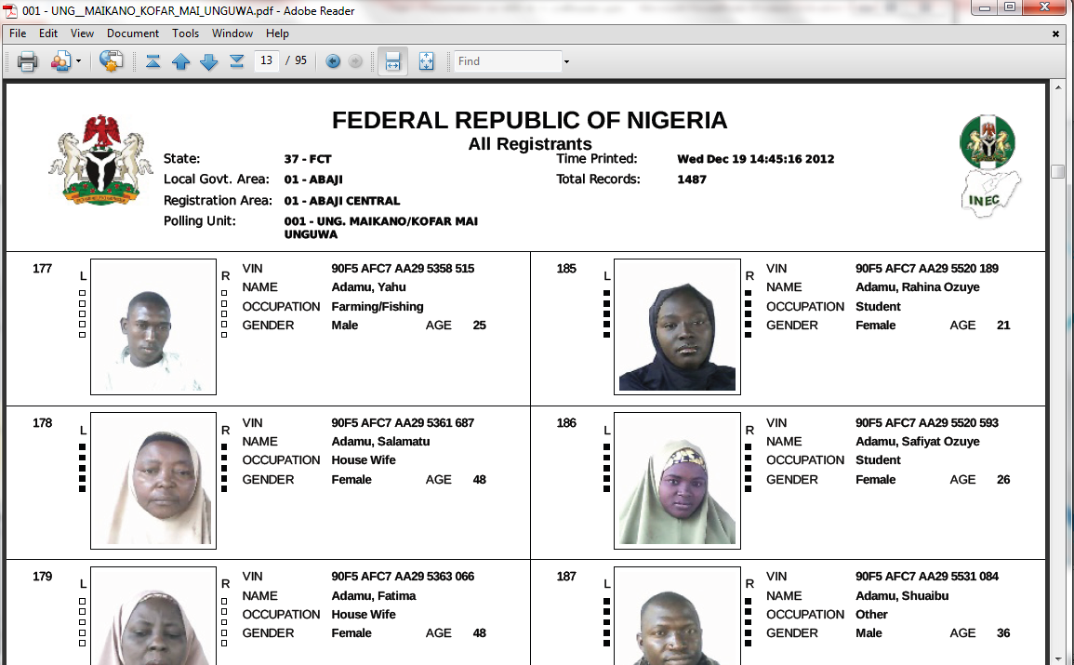
ELECTRONIC VOTER REGISTER
Notes:
This is another option for an Overview slides using transitions.

Slide 4
VR PROCESS
The data of collected for each registrant are:
Bio- Data
Facial Image
10 finger prints ( Template & Image)
optional fields for those that possess National ID card and telephone numbers
The size of data captured is approx. 1MB/voter
Registered over 73M Nigerians
Each registrant has a unique identifier- Voter Identification Number (VIN)

Slide 5
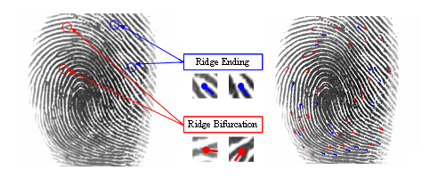
AFIS Technology
Notes:
This is another option for an Overview slides using transitions.

Slide 6
AFIS PROCESS
AFIS software allows the Commission execute a de-duplication process on its database of registered voters;
This de-duplication process is expected to identify multiple registrations and appropriately flag such.
It must also minimize the number of individuals wrongly flagged as duplicates
The de-duplication process eliminates confirmed multiple registrations;
Notes:
Give a brief overview of the presentation. Describe the major focus of the presentation and why it is important.
Introduce each of the major topics.
To provide a road map for the audience, you can repeat this Overview slide throughout the presentation, highlighting the particular topic you will discuss next.

Slide 7
CURRENT STATUS
Standardized Biometric solution developed by National Institute of Standards and Technology (NIST) for the Federal Bureau of Investigation (FBI);
Implemented a clustering solution in the National Data Center – ClusterSix, of fifty-five (55) dedicated machines constantly running the AFIS process over a network;
Exercise has revealed between 6% and 20% of duplicates in each State, about 23 States have been run successfully;
Process to complete within the second quarter of the year.

Slide 8
CRITERIA FOR DETECTING DUPLICATES
If the threshold of similarity score between two (2) or more registrants is above 200;
EAM – Equivalence Attribute Matching
Detection of Duplicate based on duplicate last name + first name + middle name + date of birth + polling unit + gender + special status
If the threshold of similarity score is between 170 and 200 implies suspected duplicate (but the registrants are not removed from the register because the certainty of being duplicates is not great).

Slide 9
Sample AFIS reports

Slide 10
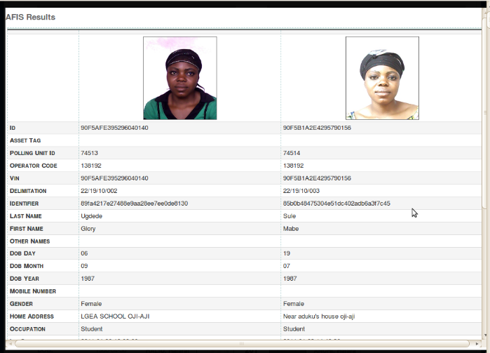
Sample AFIS report
Same person, registered in two different Polling Units.

Slide 11
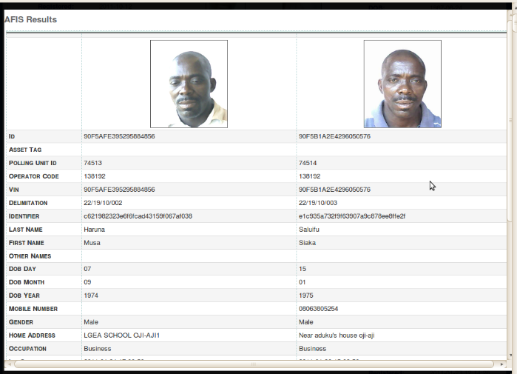
Multiple registration in different Polling Units with different names
Sample AFIS report

Slide 12
TARABA STATE STATISTICS
Server Records | 1,358,671
Announced Registrations | 1,336,221
Announced Duplicates | 41,069
No Fingerprints | 91,017
Fewer than 2 Fingerprints | 111,281
AFIS & EAM | 81,609
AFIS & EAM with fewer than 2 Fingerprints | 35,909
Final Invalid | 156,981
Valid for PVC | 1,201,690
% Duplicates (AFIS & EAM) - 6%
% Invalid for PVC Printing (AFIS, EAM & < 2 Fingerprints) – 11.6%

Slide 13
EKITI STATE STATISTICS
Server Records | 766,560
Announced Registrations | 764,726
Announced Duplicates | 2,868
Special Registrations | 49,812
No Fingerprints | 37,377
Fewer than 2 Fingerprints | 40,461
AFIS & EAM | 78,046
AFIS & EAM with fewer than 2 Fingerprints | 14,294
Final Invalid | 104,213
Valid for PVC | 662,347
% Duplicates (AFIS & EAM) - 10.2%
% Invalid for PVC Printing (AFIS, EAM & < 2 Fingerprints) – 13.6%

Slide 14
ANAMBRA STATE STATISTICS
Server Records | 1,811,530
Announced Registrations | 2,011,746
Announced Duplicates | 33,747
Special Registrations | 69,475
No Fingerprints | 48,276
AFIS & EAM | 115,884
Final Invalid | 89,868
Valid | 1,721,662
% Invalid for PVC Printing (AFIS, EAM & < 2 Fingerprints) – 5.2%

Slide 15
INDICATORS
From the AFIS run, and from the data delivered for the printing of Permanent Voters Cards, between 10 – 20% of voters would not be issued cards.

Slide 16
ISSUES WITH AFIS RUN
POWER – being the major challenge to the successful execution of the project;
Power surges recently pulled down the cooling systems at the National Data Centre (NDC)
Impact on the Project:
Time
Cost

Slide 17
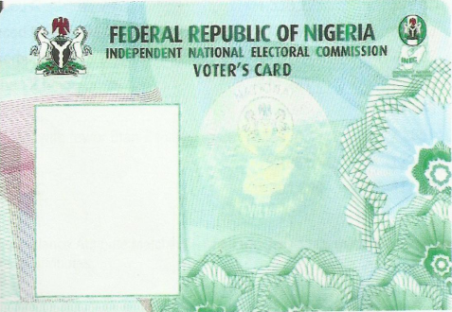
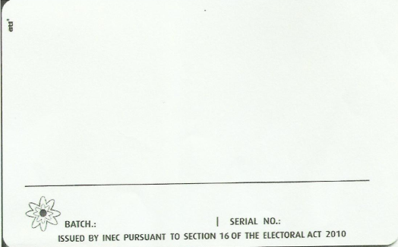

PERMANENT VOTER
CARD
(PVC)
Sample Base Card

Slide 18

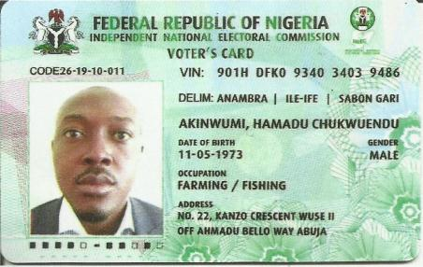
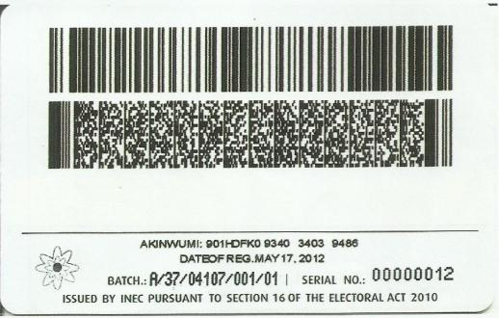
Personalised Card Sample

Slide 19
ABOUT THE PROJECT
Smart card-based Voter ID;
Stores voter’s information such as bio-data, biometrics and facial image;
The card technology protects the stored information (physical and logical security) to reduce vulnerability to counterfeiting;
Has a read & write chip;
Ten years durability; and
To be used for electronic identification and authentication of voters during general elections

Slide 20
CHARACTERISTICS OF THE CARD
Card Substrate - Polyvinyl Chloride Card (PVC) due to the limited rate of use, resistance to heat, flexing and ultra violet.
Visual Security on the Card
Custom-designed holographic over laminates, pre-printed microtext, Guilloche Graphics and barcodes
Technology of the card - Smart Card – Contactless (ISO 14443A standard) with a straight memory chip. The memory chip will store voters Bio-data and the Finger print template
Card Orientation - Landscape orientation because of the chip and photograph
Graphics and Type face - Bright colours, Texture Background, card holder photograph and good type face
Print, Encode and Laminate - High definition printing because of the embedded electronics and quality image

Slide 21
PVC PROJECT STATUS
1
2
Delivery of these cards to the Commission is on-going
3
INEC has employed the services of an Independent Card Assessor to confirm that card quality meets specifications
PVC first phase has commenced, to print forty million (40,000,000) voters’ cards
4
The memo for the award of the concluding phase of the project is before the Federal Executive Council (FEC)
Notes:
This is another option for an Overview slide.

Slide 22
ISSUES WITH PVC PROJECT
Late commencement of the project;
The need to complete AFIS run on the data for each State before printing the PVC;
State AFIS takes a while – continuous process run for weeks non-stop.

Slide 23
ACTIONS …
AFIS completed by Mid-year
Get more processors to increase speed
Get stable Power at the NDC
Progress

Slide 24
CONCLUSION?
Notes:
Use a section header for each of the topics, so there is a clear transition to the audience.

Slide 25
Thank you

